Slide 1
Object Oriented Programming METHODOLOGY
Ruchika Patil
ruchika.rp@somaiya.edu

Slide 2
OUTLINE
Introduction to Vector Class
Vector Declaration
Vector Constructors
Vector Methods
ArrayList vs Vector
Wrapper Classes

Slide 3
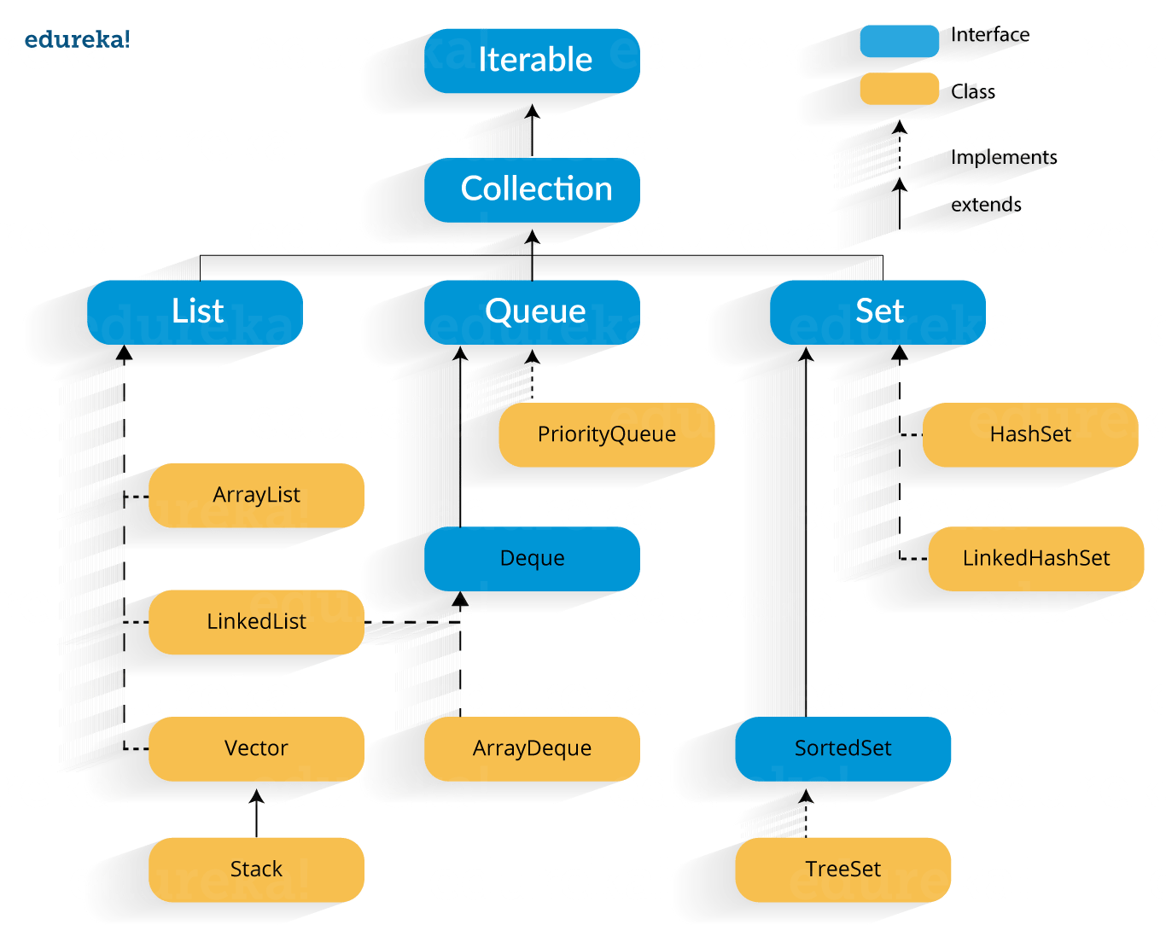
Java Collection Framework Hierarchy
https://www.edureka.co/blog/java-collections/#interface

Slide 4
What is Java Vector Class?
Vector implements a dynamic array.
Not limited to a specific size
Similar to ArrayList, but with two differences :
Vector is synchronized.
Vector contains many legacy methods that are not part of the collections framework.
Vector is Extends AbstractList and implements List interface.
Introduced in JDK 1.0
import java.util.Vector

Slide 5
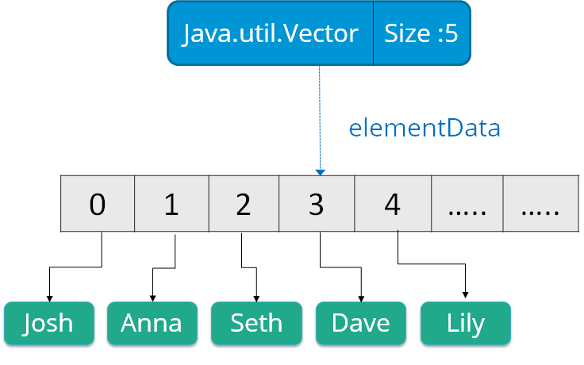
Vectors can hold objects of any type and any number.
Access the data members simply by using the index of the element

Slide 6
Java Vector class Declaration
Vector is declared like this:
public class Vector<E> // E specifies the type of element to be stored.
extends Object<E>
implements List<E>, Cloneable, Serializable

Slide 7
Java Vector Constructors

Slide 8
Java Vector Constructors
Vector class supports four types of constructors.
(1) Vector v = new Vector();
It constructs an empty vector with the default size as 10.
when maximum size of the Vector is reached ->
Capacity = New Vector size = 2 * current size (double in size)
(2) Vector v = new Vector(int initialCapacity);
It creates an empty Vector object of specified size (or initial capacity)

Slide 9
Java Vector Constructors
(3) Vector v = new Vector(int initialCapacity, int incrementalCapacity);
creates an empty Vector object of specified size (or initial capacity) and capacity increment.
when maximum size is reached, new vector is created with a size of
(old vector size + increment capacity value)
(4) Vector v = new Vector(Collection c);
It constructs a vector that contains the elements of a collection c.
it is basically used for inter-conversion between collection objects

Slide 10
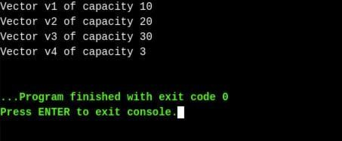
Example: Initializing Vector Constructors
// Java code illustrating Vector Constructors
import java.util.*;
public class Main{
public static void main(String[] args)
{
// create default vector
Vector v1 = new Vector();
// create a vector of given Size
Vector v2 = new Vector(20);
// create a vector of given Size and Increment
Vector v3 = new Vector(30,10);
v2.add(100);
v2.add(100);
v2.add(100);
// create a vector with given collection
Vector v4 = new Vector(v2);
System.out.println("Vector v1 of capacity " + v1.capacity());
System.out.println("Vector v2 of capacity " + v2.capacity());
System.out.println("Vector v3 of capacity " + v3.capacity());
System.out.println("Vector v4 of capacity " + v4.capacity());
}

Slide 11
ASSIGNMENT (1)
WAJP using Vector Class which will print the following elements:
Elements are: [Apple, Orange, Kiwi, Banana, Fig]
Add 3 more elements. Display size and capacity before and after increments.

Slide 12
Example: (2)
import java.util.*;
public class VectorExample {
public static void main(String args[]) {
//Create a vector
Vector<String> vec = new Vector<String>();
//Adding elements using add() method of List
vec.add("Tiger");
vec.add("Lion");
vec.add("Dog");
vec.add("Elephant");
//Adding elements using addElement() method of Vector
vec.addElement("Rat");
vec.addElement("Cat");
vec.addElement("Deer");
System.out.println("Elements are: "+vec);
}
}

Slide 13
Memory allocation of vectors
Vectors can change their size based on two fields ‘capacity’ and ‘capacityIncrement’
Vectors do not contain real objects, but only references to the objects.

Slide 14
Java Vector Methods

Slide 15
Java Vector Methods
SN | Method | Description
1) | add() | It is used to append the specified element in the given vector.
2) | addAll() | It is used to append all of the elements in the specified collection to the end of this Vector.
3) | addElement() | It is used to append the specified component to the end of this vector. It increases the vector size by one.
4) | capacity() | It is used to get the current capacity of this vector.
5) | clear() | It is used to delete all of the elements from this vector.
6) | clone() | It returns a clone of this vector.

Slide 16
Java Vector Methods
SN | Method | Description
7) | contains() | It returns true if the vector contains the specified element.
8) | containsAll() | It returns true if the vector contains all of the elements in the specified collection.
9) | copyInto() | It is used to copy the components of the vector into the specified array.
10) | elementAt() | It is used to get the component at the specified index.
11) | elements() | It returns an enumeration of the components of a vector.
12) | ensureCapacity() | It is used to increase the capacity of the vector which is in use, if necessary. It ensures that the vector can hold at least the number of components specified by the minimum capacity

Slide 17
Java Vector Methods
SN | Method | Description
13) | equals() | It is used to compare the specified object with the vector for equality.
14) | firstElement() | It is used to get the first component of the vector.
15) | forEach() | It is used to perform the given action for each element of the Iterable until all elements have been processed or the action throws an exception.
16) | get() | It is used to get an element at the specified position in the vector.
17) | hashCode() | It is used to get the hash code value of a vector.
18) | indexOf() | It is used to get the index of the first occurrence of the specified element in the vector. It returns -1 if the vector does not contain the element.
19) | insertElementAt() | It is used to insert the specified object as a component in the given vector at the specified index.

Slide 18
ASSIGNMENT (2)
Create an empty vector, add (min 8) elements in the vector. WAJP to:
Display vector elements
Delete first occurrence of the element.
Remove element at index 4.
Get element at specific index
Check if the vector is empty
Get HashCode for this vector

Slide 19
ASSIGNMENT (3)
Enter lines of input, use quit to end the program.
apple
orange
banana
grape
lemon
quit
Number of lines: 5
Middle line: banana
Lines in reverse order:
lemon
grape
banana
orange
apple
Lines in reverse alphabetical order:
orange
lemon
grape
banana
apple
Write a java application program
that uses Vector class
and can output the result as
shown in the right.

Slide 20
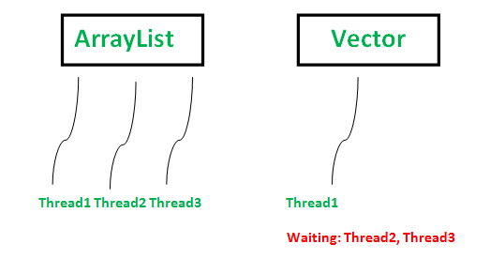
Vector V/S Array List
1) Synchronization:
2) Performance: ArrayList is faster
3) Data Growth:
ArrayList increments 50% of the current array size
vector increments 100% – essentially doubling the current array size.
4) Traversal: Vector can use both Enumeration and Iterator for traversing over elements of vector while
ArrayList can only use Iterator for traversing.
5) Applications : Most of the time, programmers prefer ArrayList over Vector

Slide 21
Vector V/S Array List
Vector | ArrayList
Present since the initial version of Java(JDK 1.0 version). | Introduced in Java since JDK 1.2
Vector is a legacy class of Java. | ArrayList is a part of the Java Collections Framework.
Vector grows double its size when its capacity is reached. | ArrayList grows by half the size when its capacity is reached.
Vector methods are synchronized. | ArrayList is not synchronized.
Vector uses Enumerator and Iterator for traversing. | ArrayList uses only Iterator.
Vector operations are slower. | ArrayList is faster.
Vector has increment size using which vector size can be increased. | ArrayList does not provide increment size.
Vector is thread-safe which means using Vector from multiple threads is permitted and is safe. | ArrayList is not thread-safe.

Slide 22
Vector constraints
Cannot directly store simple data type in a vector we can only store objects.
We can convert simple types to objects using wrapper classes.
Important Vector methods are
list.addElement(item) – adds the item to the list at the end
list.elementAt(5) – gives the name of the 5th object
list.size() – gives the number of objects present l
ist.removeElement(item) – removes the specified item from the list
list.removeElementAt(n) – removes the item stored in the nth position of the list list.removeAllElements() – removes all the elements in the list
list.copyInto(array) – copies all items from list to array
list.insertElementAt(item,n) – inserts the item at nth position

Slide 23
Program to explain working with Vectors
import java.util.*;
Class TestVector
{
public static void main(String args[])
{
Vector list= new Vector();
int length=args.length;
for(int i=0;i<length;i++)
{
list.addElement(args[i]);
}
list.insertElementAt(“COBOL”,2);
int size = list.size();
String listaray[] = new String[size];
list.copyInto(listarray);
System.out.println(“List of Languages”);
for(int i=0;i<size;i++)
{
System.out.println(listarray[i]);
}
}
}

Slide 24
Wrapper Classes

Slide 25
Wrapper Classes
Vectors can not handle primitive data types like int,float,long,double,char etc.
Primitive data types can be converted into objects types by using wrapper classes contained in the java.lang package
Following are the data types and their corresponding wrapper class types.
Primitive Type | Wrapper class
boolean | Boolean
char | Character
byte | Byte
short | Short
int | Integer
long | Long
float | Float
double | Double

Slide 26
Following are the conversation from primitive data types to object numbers using constructor Methods
Integer IntVal = new Integer(i) //primitive integer to Integer Object
Converting Object numbers to Primitive numbers using typeValue() method
Int I = IntVal.intValue(); // Object to primitive integer
Converting numbers to Strings using to String() method
Str = Integer.toString(i); //primitive integer to string
Converting String Object to Numeric Objects using the static method ValueOf()
IntVal = Integer.ValueOf(str); // Converts string to Integer Object
Converting Numeric String to Primitive Numbers Using Parsing Methods
int I = Integer.parseInt(str);

Slide 27
Wrapper class Example: Primitive to Wrapper
//Java program to convert primitive into objects
//Autoboxing example of int to Integer
public class WrapperExample1{
public static void main(String args[]){
//Converting int into Integer
int a=20;
Integer i=Integer.valueOf(a);//converting int into Integer explicitly
Integer j=a;//autoboxing, now compiler will write Integer.valueOf(a) internally
System.out.println(a+" "+i+" "+j);
}}
Autoboxing: Automatic conversion of primitive types to the object of their corresponding wrapper classes is known as autoboxing.

Slide 28
Wrapper class Example: Wrapper to Primitive
//Java program to convert object into primitives
//Unboxing example of Integer to int
public class WrapperExample2{
public static void main(String args[]){
//Converting Integer to int
Integer a=new Integer(3);
int i=a.intValue();//converting Integer to int explicitly
int j=a;//unboxing, now compiler will write a.intValue() internally
System.out.println(a+" "+i+" "+j);
}}
Unboxing: It is just the reverse process of autoboxing. Automatically converting an object of a wrapper class to its corresponding primitive type is known as unboxing.

